Slide 1
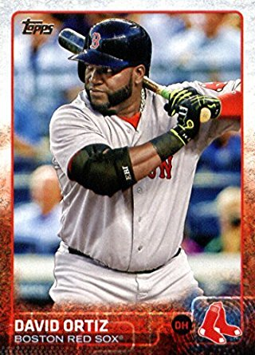
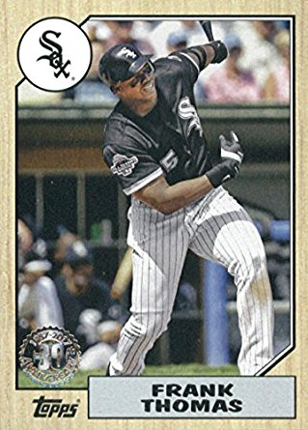

SPS/MA 226 Portfolio Presentation:
Frank Thomas & David Ortiz
By Jake Ziegler & Michael Dalton

Slide 2
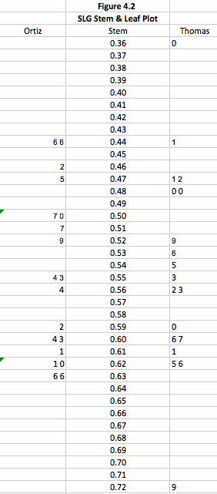
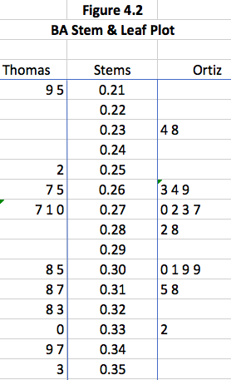
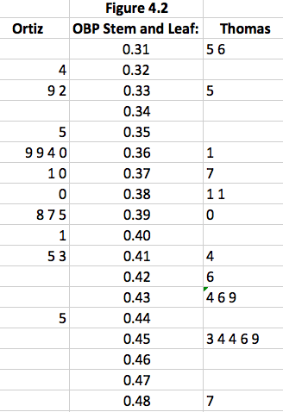
Stem/Leaf Plot Comparisons

Slide 3
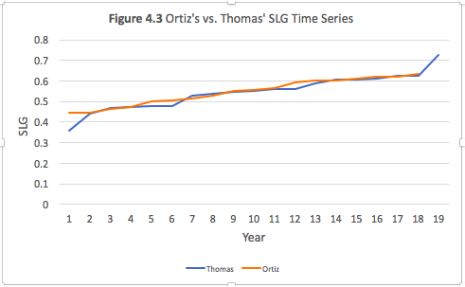
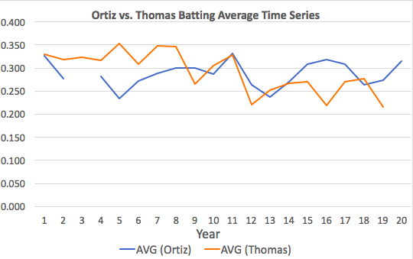
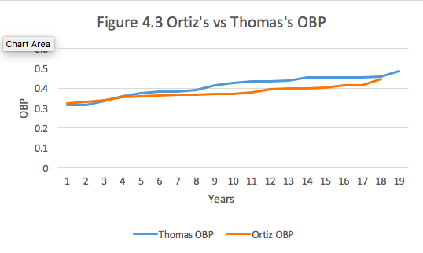
BA, OBP, SLG Time Series Comparisons

Slide 4
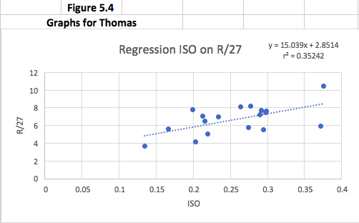
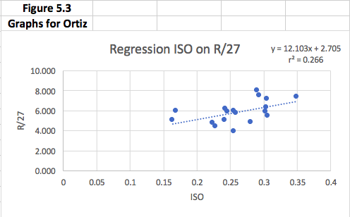
ISO on R/27 Regression Analysis

Slide 5
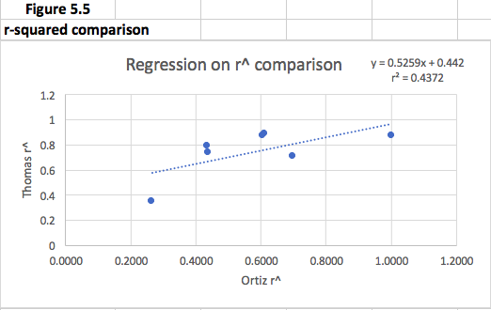
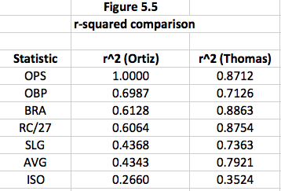
Comparison of R-squared Values

Slide 6
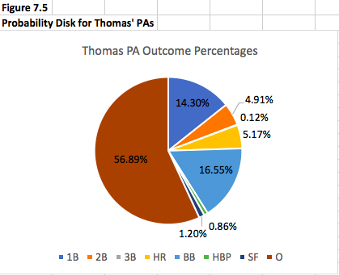
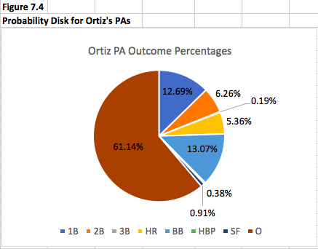
Plate Appearance Probability Disks

Slide 7
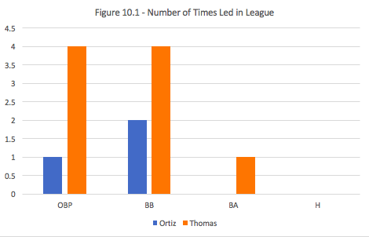
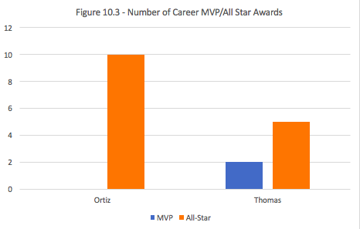
American League Career Leaders (MVP/All-Star, No. 1 in OBP, BB, BA, H)

Slide 8
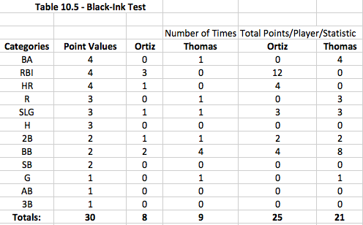
Black-Ink Test Results

Slide 9
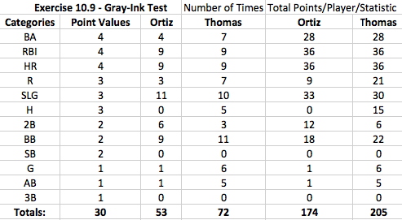
Gray-Ink Test Results

Slide 10
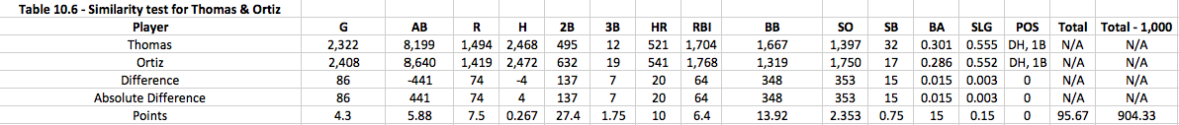
Similarity Test Results

Slide 11
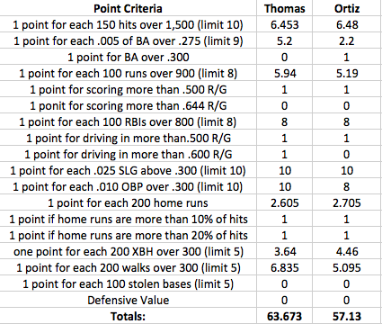
Hall of Fame Career Standards Test Results

Slide 12
Final Argument
David Ortiz should be inducted into the National Baseball Hall of Fame
17th all-time in home runs (541)
T-103rd all-time in hits (2,472)
Isn’t ranked in the top 10 in career postseason games played, but is ranked 10th all-time in career postseason hits (88), 4th all-time in career postseason doubles (22), T-7th all-time in career postseason home runs (17), T-4th all-time in career postseason RBI’s (61)
Scored higher on the Black-Ink test (25) than Thomas (21); the average score is 27
Scored a 174 in the Hall of Fame Career Standards Test; the average score is 132
Has a significant higher number of personal accolades than Thomas received over his career. Ortiz is a 10-time all-star and a 7-time silver slugger

